Slide 1

7th Grade Math
Unit 6, Lesson 1 Paying Your Way in Mathlandia Volume 1, pg. 237

Slide 2


Benchmark
MA.7.AR.3.3
Solve mathematical and real-world problems involving the conversion of units across different measurement systems.
volume 1, pg. 237

Slide 3
Integrated Mathematical Thinking and Reasoning Standards
MA.K12.MTR.1.1 Actively participate in effortful learning both individually and collectively.
MA.K12.MTR.4.1 Engage in discussions that reflect on the mathematical thinking of self and others.
volume 1, pg. 237

Slide 4

Learning Target
I can determine the exchange rate between two forms of currency.
volume 1, pg. 237

Slide 5

Warm-Up
volume 1, pg. 237

Slide 6
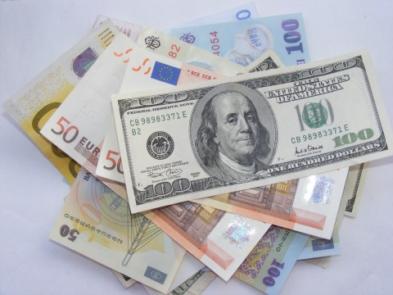
6.1.1 Warm-Up: Currency Exchanges
If you travel to another country, chances are you’ll need to exchange currency. For example, this could mean exchanging U.S. dollars for pesos of an equivalent value while visiting Mexico. Almost no two currencies are worth the same amount and their values change daily, sometimes even hourly. Currency exchange rates are used to determine the equivalent values at the time of exchange.
volume 1, pg. 237

Slide 7
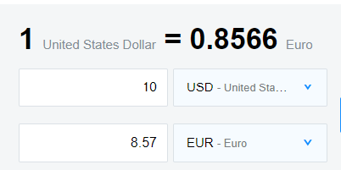
What are two things you wonder about currency exchanges?
An example of a currency exchange calculator is shown.
What are two things you notice?
volume 1, pg. 237

Slide 8
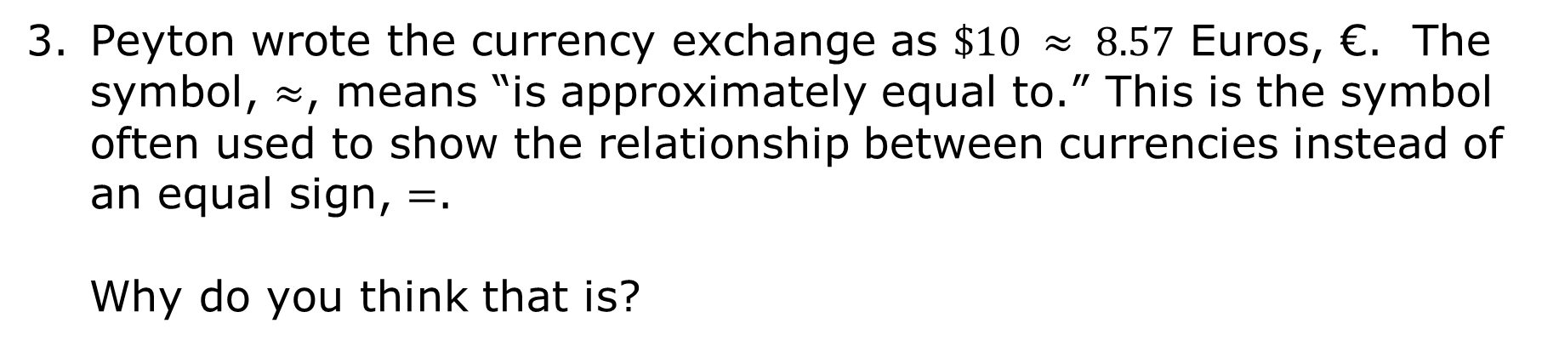
Peyton wrote the currency exchange as $\$10 ≈ 8.57$ Euros, €. The symbol, $≈$, means “is approximately equal to.” This is the symbol often used to show the relationship between currencies instead of an equal sign, $=$.
Why do you think that is?
volume 1, pg. 238

Slide 9

Exploration
volume 1, pg. 238

Slide 10

6.1.2 Exploration: Journey Through Mathlandia
In class today, you will visit different countries in Mathlandia. In each country, you will see sets of souvenir items of the same value for sale, but with prices in each country’s currency. Use the table to record the prices of the items in each country. Place a star beside your “home” country. As you visit each country, you will work together to determine the exchange rate in comparison to your “home country.” Happy travels!
In the first column of the table, each country’s name is listed in bold. The country’s currency is listed below the country’s name with the symbol for its units in parentheses.
Write your “home” country’s name and currency on the lines provided.
volume 1, pg. 238

Slide 11
“Home” Country Name _________________
currency (units) ___________________
Price of Goods by Country
 | Mug | Keychain | Magnet | T-shirt | Picture Frame
Scalenia sal (§)
Prismopolis peak (ᐰ)
Proportia pop (ᖘ)
volume 1, pg. 238

Slide 12
Equivaland equi (ᕮ)
Variableya var (ṽ)
Integerina op (⊕)
volume 1, pg. 238

Slide 13
Complete the statement to summarize the information given about the souvenir items in each country, using the words or phrases in the bank.
currency equal to value
Each type of souvenir has the same ____________, which means it is worth the same amount of money. The price of each item is listed in that country’s ____________. Because the price of each souvenir from each country has the same value, the prices in different currencies can be set ____________ each other. This can then be used to determine a currency exchange rate that can be used to approximate the cost of other items.
volume 1, pg. 239

Slide 14
With your partner, discuss how this information can be used to find the exchange rate between two currencies. Write a summary of your discussion.
Show an example of how to find the exchange rate between two currencies. Be sure to label the units.
volume 1, pg. 239

Slide 15
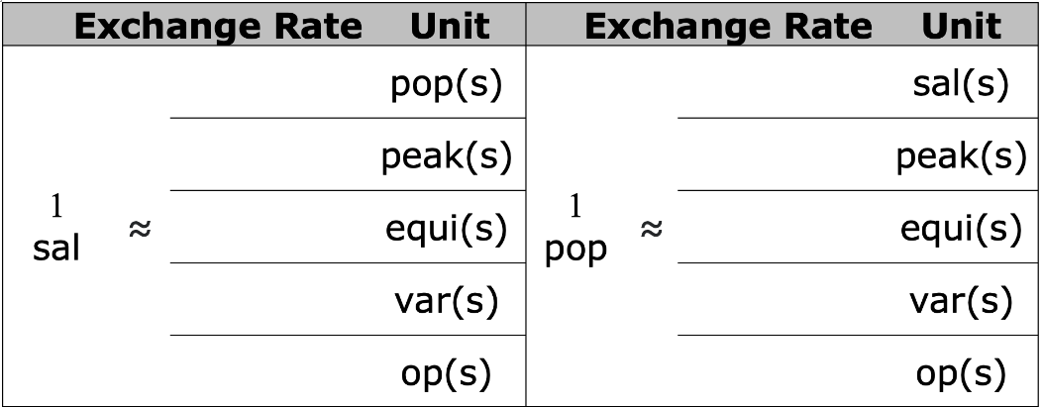
Use the information you gathered on your journey to calculate the exchange rates for each of the other currencies in comparison to your “home” currency. Record them in the section of the table for your “home” country’s currency. Round to the nearest hundredth.
volume 1, pg. 239

Slide 16
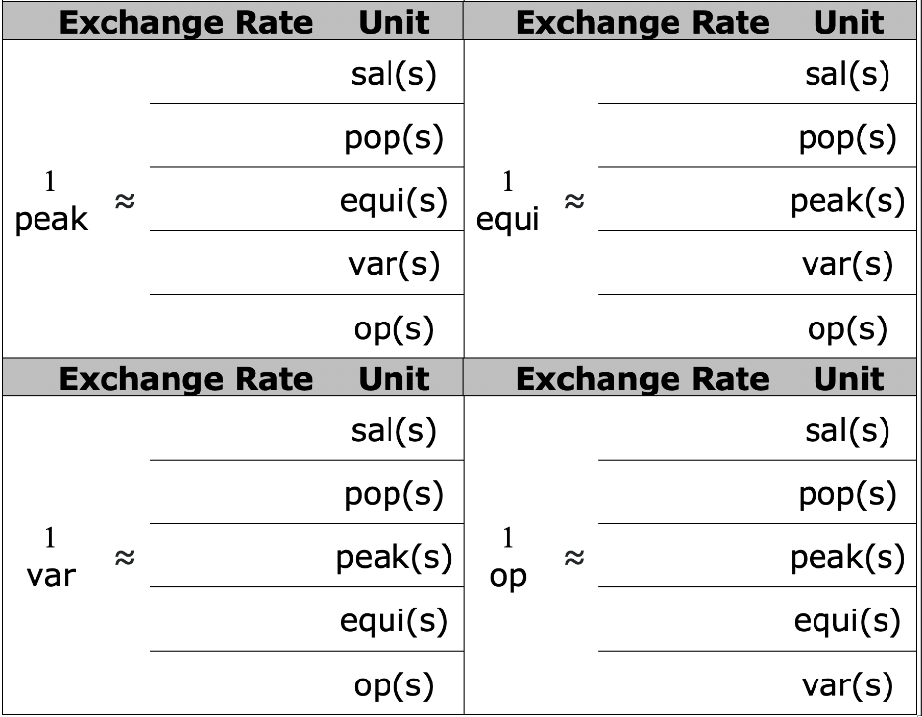
Review the exchange rates displayed by other groups. Complete the table with the exchange rates for each currency.
volume 1, pg. 239

Slide 17

Bring It Together
volume 1, pg. 240

Slide 18

6.1.3 Bring It Together: Exchanging Currency
Write two observations you made about the currencies from the activity.
Write a ratio that can be used to represent the exchange rate of ops (⊕) to peaks (ᐰ).
Write a ratio that can be used to represent the exchange rate of peaks (ᐰ) to ops (⊕).
volume 1, pg. 240

Slide 19

What do you notice about these two ratios?
A hat costs $255$ peaks (ᐰ). Which ratio can be used to determine how much the same hat would cost in ops (⊕)?
What is the cost of the hat in ops (⊕)? Show your work.
volume 1, pg. 240

Slide 20

Wrap-Up
volume 1, pg. 240

Slide 21
6.1.4 Wrap-Up: Reflection
Complete each statement as you reflect on today’s learning.
When someone asks me what I did in math class today, I can say …
volume 1, pg. 240

Slide 22
The thing that made the most sense to me today was …
Something that I still do not understand is …
volume 1, pg. 240

